Slide 1
Web Scraping Data From
Stack Overflow
Muzalfa BiBi

Slide 2
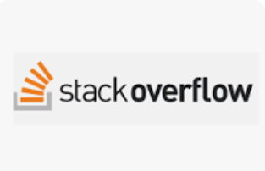
What is Stack Overflow?
Stack Overflow is a question-and-answer website for computer programmers.
It is the flagship site of the Stack Exchange Network.
It was created in 2008 by Jeff Atwood and Joel Spolsky.
It features questions and answers on certain computer programming topics..
Website Link:
Stack Overflow.com
meta.stackoverflow.com

Slide 3
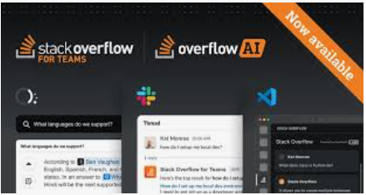
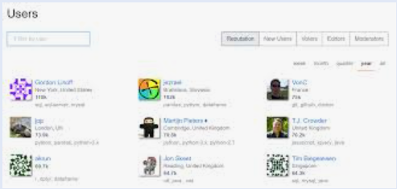
Implementation Details
Fetch URLs:
Company Data: https://stackoverflow.com/jobs/companies
User Data: https://stackoverflow.com/users
Extract Data Categories:
Images, Headings, Items, Paragraphs, Jobs, User Data
Save Data:
Each category saved into a separate text file on the desktop.
Download Images:
Image URLs processed and images saved in a dedicated folder.

Slide 4
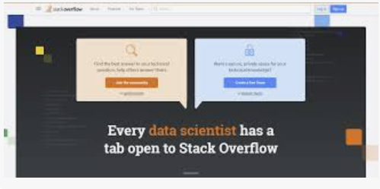
Objectives
Extract Data:
Gather specific information from Stack Overflow's job and user pages.
Store Data:
Save extracted data into separate text files.
Download Images:
Fetch and save images locally.

Slide 5

Tools and Libraries
Code:
Python: Programming language used for development.
Requests: Library for handling HTTP requests.
BeautifulSoup: Library for parsing HTML and XML documents.

Slide 6


Fetching Content
Code:
Fetch data from company:
0.“user_response” is a Variable fetch data from url
1.“requests”is a library
2.“user_url” is a Variable to sacrap data
3.“user_soup” is a Variable
4.Fetch data, parse HTML, extract data categories,
save to files, download images.
5.Exception handling included for robustness.
6.See detailed code example in the report.
Fetch data from user:

Slide 7
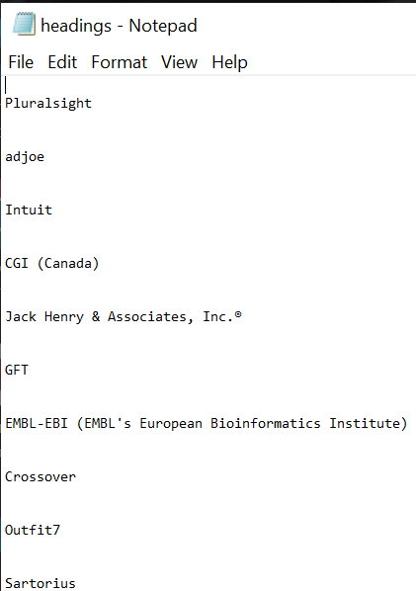
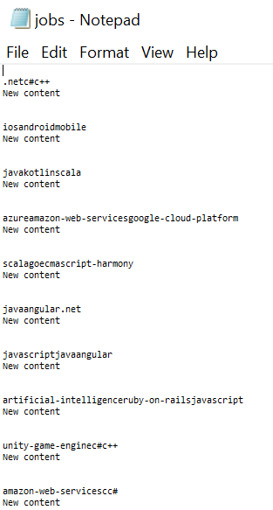
Save heading and jods
Save jobs in File :
Save heading in File :
code:
code :

Slide 8
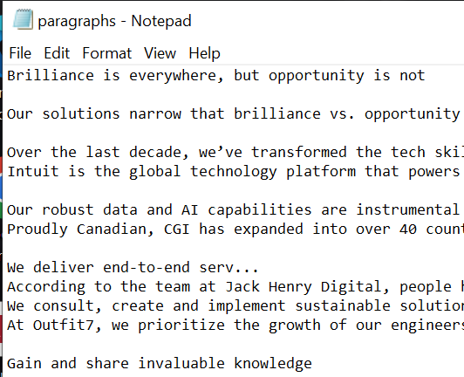
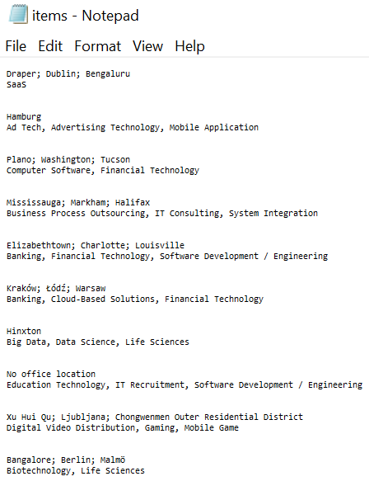
Save items and paragraph
Code:
Code:
Save paragraph in File :
Save items in File :

Slide 9
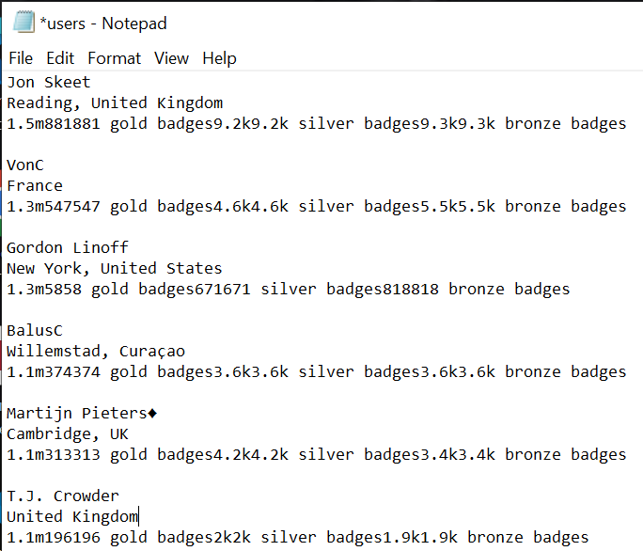
Save users data:
Code:
Save in file of users data:

Slide 10
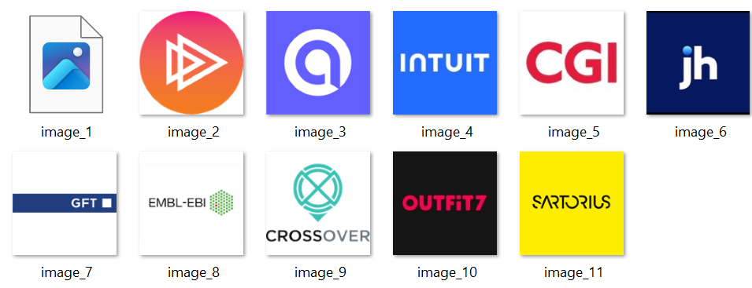
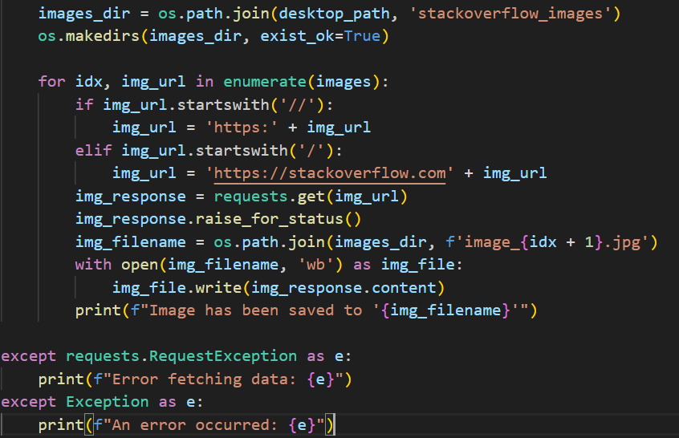
Saving and Download Images
Save images in File :
Code:

Slide 11

Challenges
Handling empty or missing fields in the job postings.
Ensuring the directory exists before saving the file.
Verifying the successful retrieval of the webpage content.

Slide 12

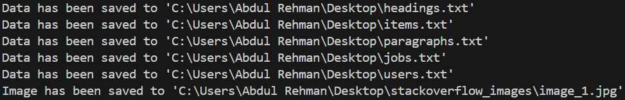
Results
Successful Execution: Data extracted and saved correctly.
Files Created: Text files on desktop with extracted data.
Images Downloaded: Images saved in a folder on desktop.
Output:

Slide 13
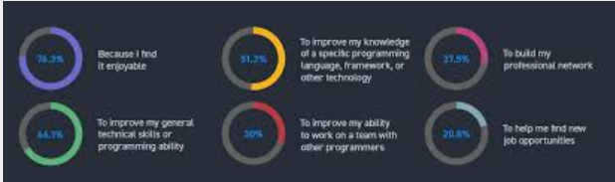
Conclusion
Achievements: Met project objectives of data extraction and storage.
Future Work: Extend project to include more data categories or additional websites.

Slide 14


